Slide 1
Explaining Threat Actors and Threat Intelligence
Lesson 2
M6S1 Introduction to Cybersecurity Defense
Notes:
The first few lessons in the course pursue the general theme of assessment. This lesson covers threat awareness and research. As with most areas of IT, it is vital to keep up to date with the latest news and trends in cybersecurity.
Topics:
Explain threat actor types and attack vectors.
Explain threat intelligence sources.

Slide 2
Explain Threat Actor Types and Attack Vectors
Topic 2A
M6S1 Introduction to Cybersecurity Defense
Notes:
Objective 1.5 is covered here and in Topic 2B. Students must be able to distinguish vulnerability, threat, and risk, and categorize threat actor types for the exam.

Slide 3
Syllabus Objectives Covered
1.5 Explain different threat actors, vectors and intelligence sources
M6S1 Introduction to Cybersecurity Defense

Slide 4
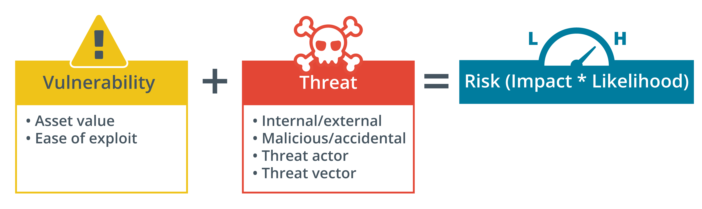
Vulnerability, Threat, and Risk
M6S1 Introduction to Cybersecurity Defense
Notes:
Make sure students can distinguish these terms and understand how assessment of vulnerability and threat facilitates calculation of risk.

Slide 5
Attributes of Threat Actors/Hackers
Known threats versus adversary behaviors
Internal/external – Financial gain/DW
Intent/motivation
Maliciously targeted versus opportunistic
Accidental/unintentional
Level of sophistication
Resources/funding – Tools, Malware, Ransom – 0.00001 BTC
Adversary capability levels
M6S1 Introduction to Cybersecurity Defense
Notes:
Note that the detailed process of analyzing the threat posed by a particular actor or adversary group is described as threat modeling. Discuss how threat sources and motivations change over time. For example, Internet threats have changed from being mostly opportunistic vandalism to structured threats associated with organized crime and state-backed groups.

Slide 6
Hackers, Script Kiddies, and Hacktivists
The “Lone Hacker”
White hats versus black hats versus gray hats
Authorized versus non-authorized versus semi-authorized
White – Gray – Black
Script kiddies -
Hacker teams and hacktivists
M6S1 Introduction to Cybersecurity Defense
Notes:
Get students to relate each of these types to intent/motivation and capability.
Terminology such as black/white hat is non-inclusive and is being replaced by neutral terms (non-authorized/authorized).

Slide 7
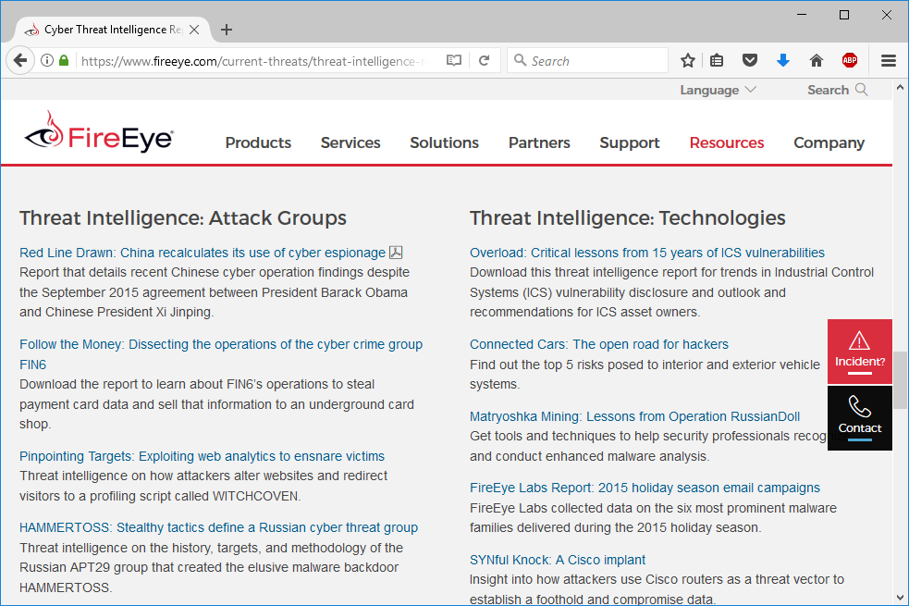
State Actors and Advanced Persistent Threats
State-backed groups
Attached to military/secret services
Highly sophisticated
Advanced Persistent Threat (APT) -(remains undetected)
Espionage and strategic advantage
Deniability
False flag operations
Screenshot used with permission from fireeye.com.
M6S1 Introduction to Cybersecurity Defense
Notes:
Get students to relate this type to intent/motivation and capability.
The Sony hack (http://www.slate.com/articles/technology/users/2015/11/sony_employees_on_the_hack_one_year_later.html) and WannaCry (wired.com/2017/05/wannacry-ransomware-hackers-made-real-amateur-mistakes), both blamed on North Korea, are good examples of state-sponsored attacks.
China's Great Cannon (computerworld.com/ article/2908504/thegreat- cannon-ofchina- enforcesinternetcensorship.html) is a good example of how nation states can deploy significant cybersecurity resources to achieve their aims.

Slide 8
Criminal Syndicates and Competitors
Criminal syndicates
Operate across legal jurisdictions
Motivated by criminal profit
Can be very well resourced and funded
Competitors
Cyber espionage
Combine with insider threat
M6S1 Introduction to Cybersecurity Defense
Notes:
SIM swap fraud is a good illustration of organized crime-type activity (digitaltrends.com/mobile/sim-swap-fraud-explained).
The Garmin ransomware incident illustrates the blurred lines between criminal syndicates, state groups, and intent/motivation (zdnet.com/article/hacker-gang-behind-garmin-attack-doesnt-have-a-history-of-stealing-user-data).

Slide 9
Insider Threat Actors
Malicious insider threat
Has or has had authorized access
Employees, contractors, partners
Sabotage, financial gain, business advantage
Unintentional insider threat
Weak policies and procedures
Weak adherence to policies and procedures
Lack of training/security awareness
Shadow IT
M6S1 Introduction to Cybersecurity Defense
Notes:
The Capital One (scmagazine.com/home/security-news/capital-one-breach-exposes-not-just-data-but-dangers-of-cloud-misconfigurations) and Twitter (vice.com/en_us/article/jgxd3d/twitter-insider-access-panel-account-hacks-biden-uber-bezos) breaches are good examples of insider threat.

Slide 10
Attack Surface and Vectors
Attack surface
Points where an attacker can discover/exploit vulnerabilities in a network or application
Vectors/Channel
Direct access
Removable media - USB
Email
Remote and wireless
Supply chain
Web and social media
Cloud
M6S1 Introduction to Cybersecurity Defense
Notes:
Note that developing new attack vectors is one of the capabilities that distinguishes threat actor groups.

Slide 11
Threat Actor Types and Attack Vectors
M6S1 Introduction to Cybersecurity Defense

Slide 12
Explain Threat Intelligence Sources
Topic 2B
M6S1 Introduction to Cybersecurity Defense
Notes:
Use of threat intelligence sources is a new area of focus for the exam, and will be a critical tool throughout the candidates' careers.
This topic covers the remaining content examples for objective 1.5.

Slide 13
Syllabus Objectives Covered
1.5 Explain different threat actors, vectors and intelligence sources
M6S1 Introduction to Cybersecurity Defense

Slide 14
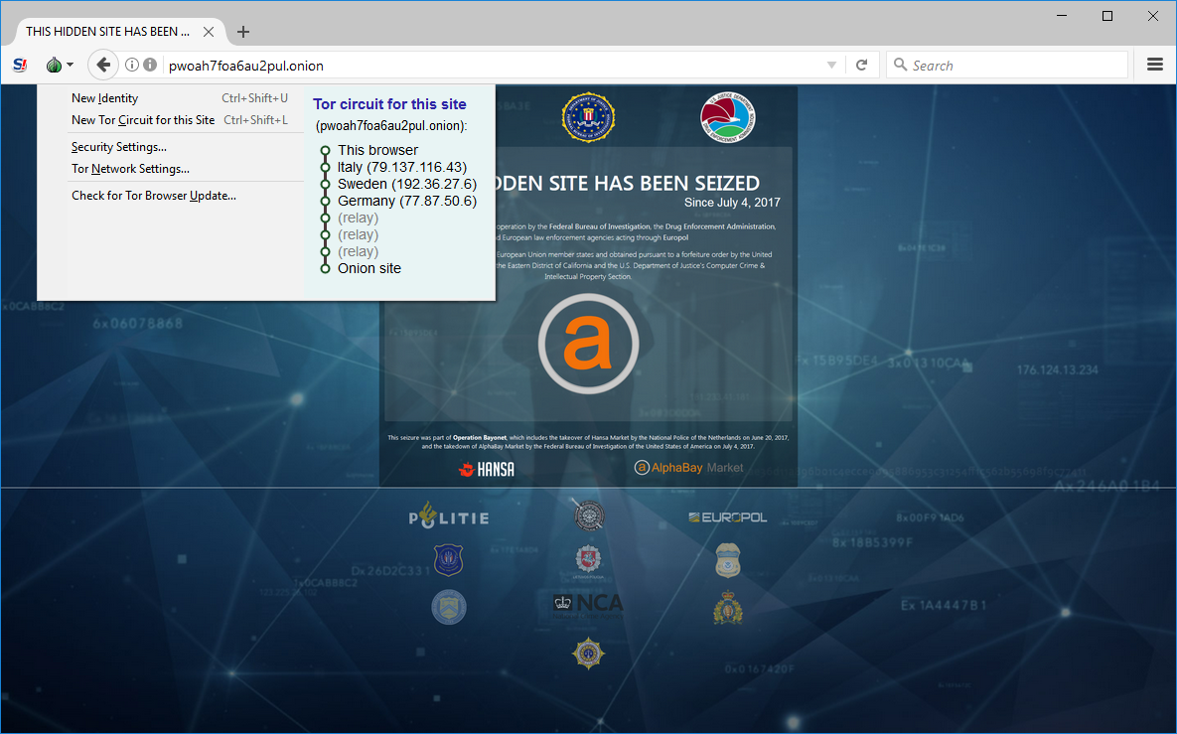
Threat Research Sources
Threat intelligence is knowledge that allows security teams to prevent or mitigate cyberattacks.
Counterintelligence
Tactics, techniques, and procedures (TTPs)
Threat research sources
Academic research
Analysis of attacks on customer systems
Honeypots/honeynets
Dark nets and the dark web
Lets dive to the darkweb later(Friday)
M6S1 Introduction to Cybersecurity Defense
Notes:
Give an overview of the purpose of threat intelligence, introducing the term TTP. Explain which companies and institutions are active in this type of research.
Make sure students know how to access dark web sites and the difficulty of performing research.

Slide 15
Threat Intelligence Providers
Narrative analysis and commentary
Reputation/threat data feeds—cyber threat intelligence (CTI)
Vlogs
Platforms and feeds
Closed/proprietary
Vendor websites
Public/private information sharing centers
Open source intelligence (OSINT) threat data sources
OSINT as reconnaissance and monitoring
M6S1 Introduction to Cybersecurity Defense
Notes:
Note the ways in which threat intelligence can be consumed. Explain that the market is a mixture of platform providers with proprietary feeds, commercial platform providers with open-source feeds, open-source platforms and feeds, and open-source feeds with no associated platform.

Slide 16
Other Threat Intelligence Research Sources
Academic journals
Conferences
Request for Comments (RFC)
Social media
M6S1 Introduction to Cybersecurity Defense
Notes:
You should not need to spend too long on this—just make students aware of these sources.

Slide 17
Tactics, Techniques, and Procedures and Indicators of Compromise
Tactics, Techniques, and Procedures (TTPs)
Generalized statement of adversary behavior
Campaign strategy and approach (tactics)
Generalized attack vectors (techniques)
Specific intrusion tools and methods (procedures)
Indicator of compromise (IoC)
Specific evidence of intrusion
Individual data points
Correlation of system and threat data
AI-backed analysis
Indicator of attack (IoA)
M6S1 Introduction to Cybersecurity Defense
Notes:
Make sure students can use this terminology.

Slide 18
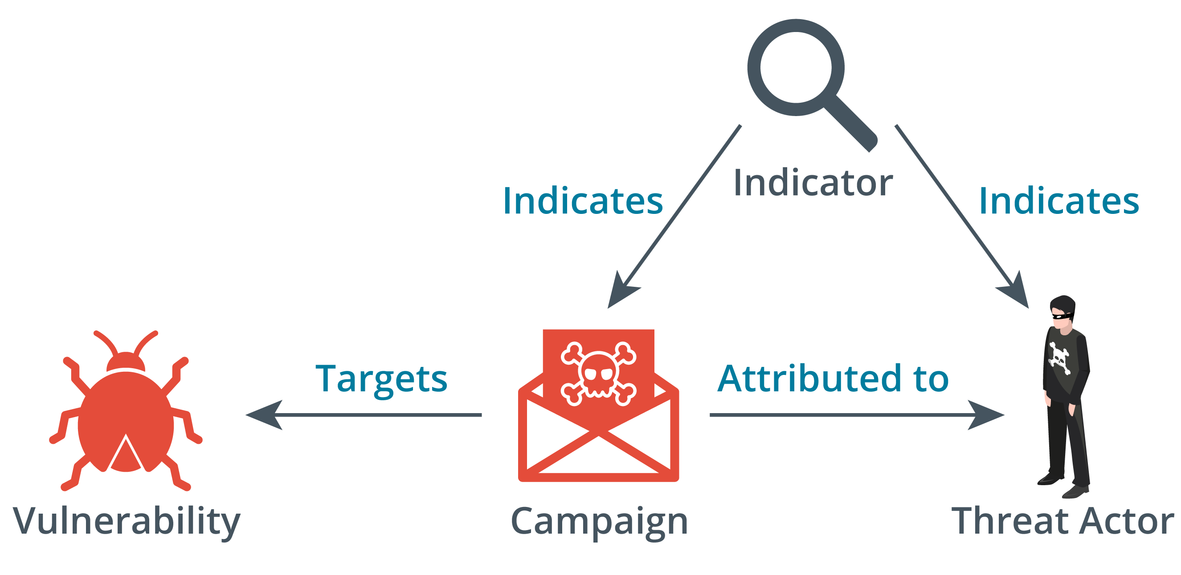
Threat Data Feeds
is an ongoing stream of data related to potential or current threats to an organization's security
Structured Threat Information exchange (STIX)
Trusted Automated Exchange of Indicator Information (TAXII)
Automated Indicator Sharing (AIS)
Threat maps
File/code repositories
Vulnerability databases and feeds
Icon images © Copyright 2016 Bret Jordan. Licensed under the Creative Commons Attribution-ShareAlike (CC BY-SA) License, Version 4.0. (freetaxii.github.io/stix2-icons.html.
M6S1 Introduction to Cybersecurity Defense
Notes:
Make sure students can distinguish STIX and TAXII.
Note that we'll cover vulnerability assessment in the next lesson.
You can show some other threat map examples, such as CheckPoint's (threatmap.checkpoint.com). Kaspersky's is visually impressive too (cybermap.kaspersky.com).

Slide 19
Artificial Intelligence and Predictive Analysis
Correlation between security intelligence/event monitoring and threat data
Artificial intelligence (AI) and machine learning (ML)
Expert systems
Artificial neural networks (ANN)
Inputs, outputs, and feedback
Objectives and error states
Predictive analysis
Threat forecasting
Monitor “chatter”
M6S1 Introduction to Cybersecurity Defense
Notes:
Note that security tools are increasingly making use of AI and ML techniques. We will be referring to these again when looking at SIEM and SOAR analytics and incident response.

Slide 20
Threat Intelligence Sources
M6S1 Introduction to Cybersecurity Defense

Slide 21
Summary
Lesson 2
M6S1 Introduction to Cybersecurity Defense
Notes:
Check that students are confident about the content that has been covered. If there is time, re-visit any content examples that they have questions about. If you have used all the available time for this lesson block, note the issues, and schedule time for a review later in the course.
Optionally, discuss with students how threat intelligence platforms and data feeds could be used within their own workplaces, or how these resources have already been implemented, and how successful they have proved.

